Slide 1
Getting started!
Rotary Community Groups
Establishment Meetings
Jyoti, Rotarian since 2016.

Slide 2
Welcome
Introductions
Purpose
The purpose is to set the scene and prepare for the election of your Rotary Community Leader (RCL)
Welcome
and
purpose

Slide 3
First, we need to go back a step:
What are the Rotary Community Groups for? Why did we change?
How will they work?
You may have other questions – there will be a chance to ask them
Background

Slide 4
Rotary in our Zone is in free fall
Fewer clubs with fewer members – depleted in numbers and energy
Why did we change to Rotary Community Groups?
Not all clubs! But EVERY District in our Zone is declining

Slide 5
We are not going to be the generation that stands by!
We need an ‘energy boost’ and we need it fast
Where does that come from?
Why did we change to Rotary Community Groups?
RCG
Boosting numbers and energy through collaboration
Growing Rotary one RCG at a time:
Increasing community impact
Raising Rotary’s profile
Attracting and engaging members
New clubs and satellite clubs

Slide 6
Each RCG creates its own growth plan/s (may be more than one)
Facilitated by your Rotary Community Leader
Clubs look at how they want and need to develop eg:
if your RCG is planning a major membership drive, how welcoming and attractive is your club?
if your RCG is planning a multi-club project, how engaged are your members?
How will they work?

Slide 7
The RCG and the clubs in the group will have a lot of support
peer support within the group
support from the Rotary Community Leader
support from Rotary Specialists
tools, resources and initiatives from the Membership Portfolio Committee
public image materials and campaigns
high level partnerships
more efficient, technology enabled administration
Let’s look at that…
How will they work?

Slide 8
Club support network
Zone 8 Rotary and Rotaract clubs
Grouped into Rotary Community Groups (RCGs)
Portfolio Committees
Rotary Specialists
Each RCG supported by a Rotary Community Leader (RCL)
District Teams
(Agreed responsibilities will transfer to relevant Portfolio Committees)
Rotary International Sydney Office
Committees
E.g. Multi-National Advisory Committee, Zone Insurance and Protection Committee
Portfolio Leads
Rotaract Nominee
RCL Nominee
District Governors
Regional Council
Rotary International
The Rotary Foundation

Slide 9
How will they work?
What other questions do you have?

Slide 10
Step Three
First meeting with your RCL
Name yourself!
Create/begin your growth plan
Include: community impact, Rotary profile, membership growth & experience
Step Two
Elect your RCL – your facilitator and partner in growth
Must be a club member in your RCG
One vote per club, preferential
Three step process to create your growth plan
Step One
Set the scene and prepare to elect your RCL (this meeting)
At every step
Bring your clubs with you!
How will you make the most of the RCG for your club?
What development does your club need?

Slide 11
Why are we doing this?
Your responses will be added to the position description for the RCL
Potential candidates will have a better idea of what the work will be like
It will also give you a chance to start thinking about who you could encourage to apply!
Step One: Set the scene and prepare to elect your community leader

Slide 12
Step One: Set the scene and prepare to elect your community leader
BRAINSTORM
What do you want to work on together?
What sort of leadership and support would help you succeed?
What arrangements will work for you?

Slide 13
Your responses will be added to the position description for the RCL
Go back to your clubs and inspire people to apply!
Nominations will be called for
Elections held where more than one candidate
Where to from here?

Slide 14
Timeline
1
November 2023
Clubs nominate their preferences
2
December 2023 – January 2024
Districts and Pilot team work together on RCGs
3
February
Clubs advised of their RCGs and Establishment Meetings set up
4
Mid Feb – mid March
Establishment Meetings held to prepare for RCL elections (1-2 leaders from each club)
5
March – April
Nominations and elections – 1 RCL for each RCG, one vote per club, preferential
6
May – June
RCLs confirmed, RCLs’ L&D program, first RCG meetings set up!
Notes:
The Establishment Meetings will consist of 1-2 leaders from each club. The District will organise a facilitator/s and liaise with the club leaders to schedule the meetings.
There will be online briefings for the facilitators. A model agenda will be provided, as well as an online form to input the results of the meeting.
The meetings will be held from mid-February to mid-March 2024. The groups will respond to three key questions: (i) what do they want to work on together? (ii) what leadership and support will they need? and (iii) how do they want to operate (meeting and collaboration arrangements etc)? This information, unique to each RCG, will be documented in the online form (provided), and added to the information package for potential candidates for the Rotary Community Leader (RCL) position.
With greater clarity about how the RCL will work with and for their group, the facilitator will encourage the club leaders to start conversations with members who have the skills and traits for the RCL role. This could include people that might not previously have aspired to a traditional leadership position in Rotary, but are excellent facilitators and strategic thinkers. Candidates need four years’ experience in Rotary, but do not need to have been a club or District officer.

Slide 15
We are not going to be the generation that stands by!
To your rockets!
RCG
Where to from here?

Slide 16
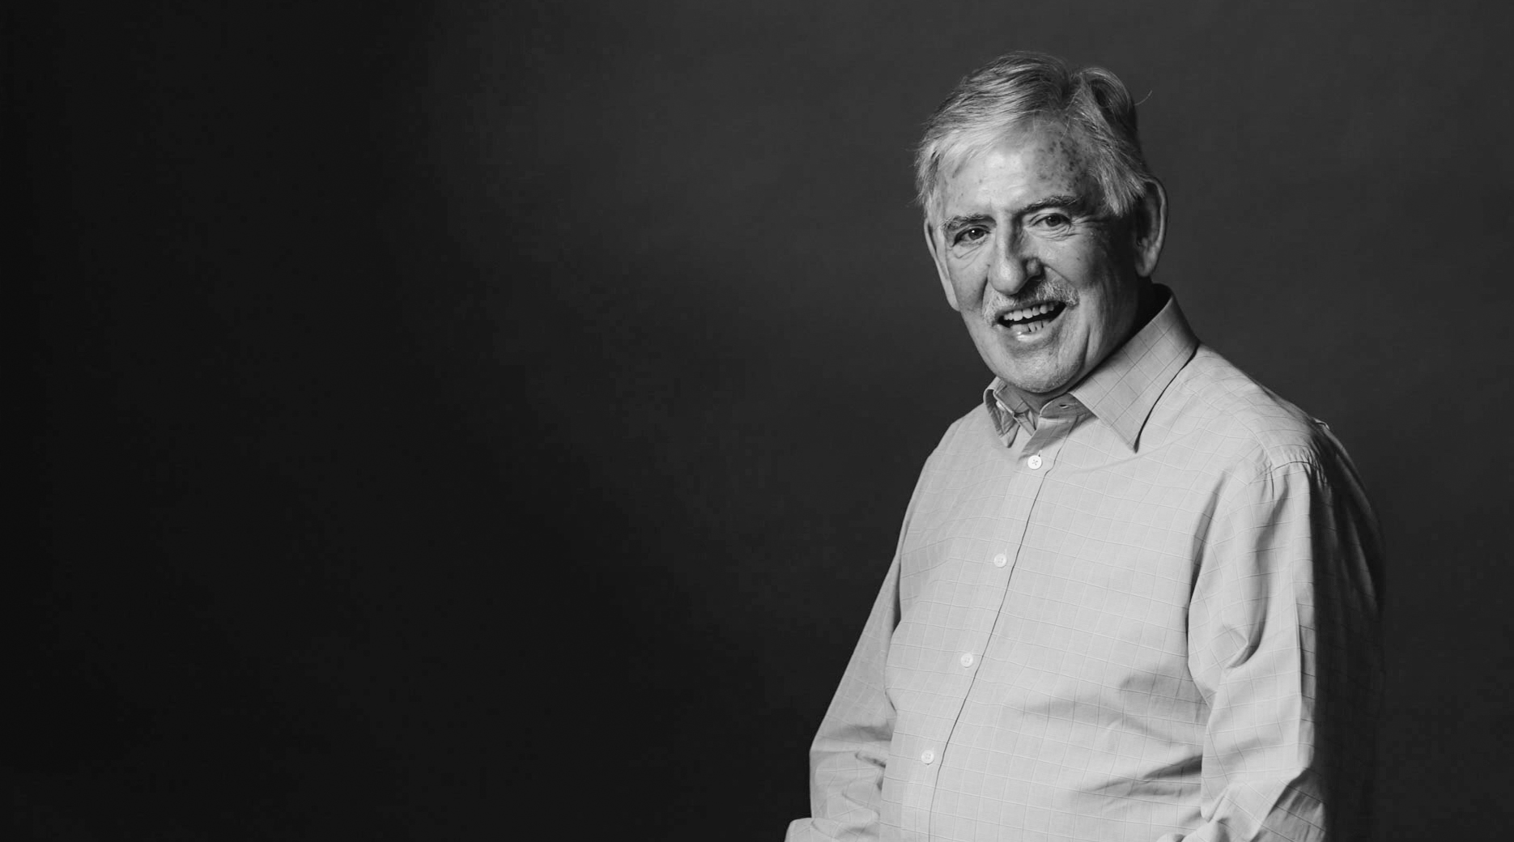
Learn more
CreatingTomorrowRotary.org
RotaryRegionalPilot@gmail.com
Follow the Pilot on Facebook

