Slide 1
Imagining
Tomorrow
Future State Workshop Report,
November 2023

Slide 2
Purpose of the report
The Future State Workshop was held to imagine what Rotary and Rotaract could look like in Zone 8 after the Regionalisation Pilot.
The Future State Workshop Report presents the outcomes of this Workshop so you can:
→ Understand what Rotary could look like after the Pilot
→ Provide feedback
The proposals in the Report are not final – we need your input!

Slide 3
What could happen to Districts?
20 Districts
Approx. 12 Districts
could transform into…
District Governors
District Leaders
could transform into…

Slide 4
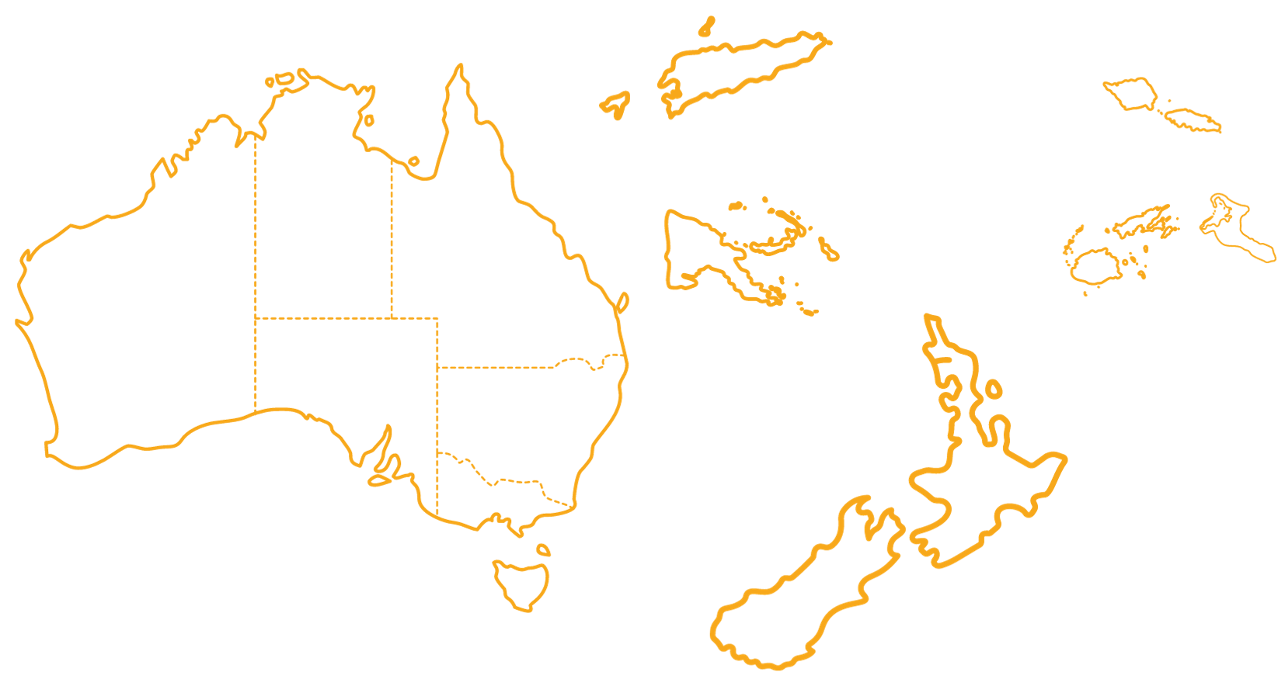
What could Districts look like?
Timor-Leste
Pacific Islands
Northern
Territory
Queensland
Western
Australia
South
Australia
Papua New Guinea
New South Wales and ACT
North Island of New Zealand
Victoria
Tasmania
South Island of New Zealand

Slide 5
What is a District Leader?
One per District
Elected by clubs in their District for two-year term
Has some delegated authority from the Regional Council
Will act as the face of Rotary and as representatives of the Regional Council in their District

Slide 6
What would District Leaders do?
Promote public image of Rotary
Act as single point of contact for people outside Rotary
Represent Rotary at events
Attend International Assembly
Work with Rotary Community Leaders
Promote The Rotary Foundation, sign Global Grants and approve use of funds
Enter agreements on behalf of Regional Council
Connect with Regional Council regularly

Slide 7
Current state
Possible future state
Titles and boundaries of Districts can be confusing. Frequent redistricting required.
Geographically based Districts that make sense in their local context.
DGs in place for one year at a time, making continuity a challenge.
District Leaders in place for at least two years (maximum of four).
No clear point of contact for external parties.
District Leaders work with external parties and enter agreements on behalf of Regional Council.
DGs promote TRF as one of their many tasks.
With a more focused workload, District Leaders have greater capacity to promote TRF.
DGEs attend International Assembly.
District Leaders attend International Assembly and convey messaging to Rotary Community Groups.

Slide 8
Potential
Operating
Model

Slide 9
Potential benefits
Enhanced support network for clubs
Less duplication of tasks
More collaboration and coordination between clubs
Greater capacity to form partnerships
One message, multiple languages
Larger scale projects with a bigger impact
More consistent public image campaigns
More appeal for prospective members

Slide 10
The future for clubs
Clubs would still:
Get to decide the best way of running their club
Have the same internal leadership roles
Get to run the projects they’re passionate about
What would change is the support network around clubs.
Clubs in Rotary Community Groups collaborate and support each other
Clubs access support through their Rotary Community Leader
Clubs receive expert guidance from Rotary Specialists as needed

Slide 11
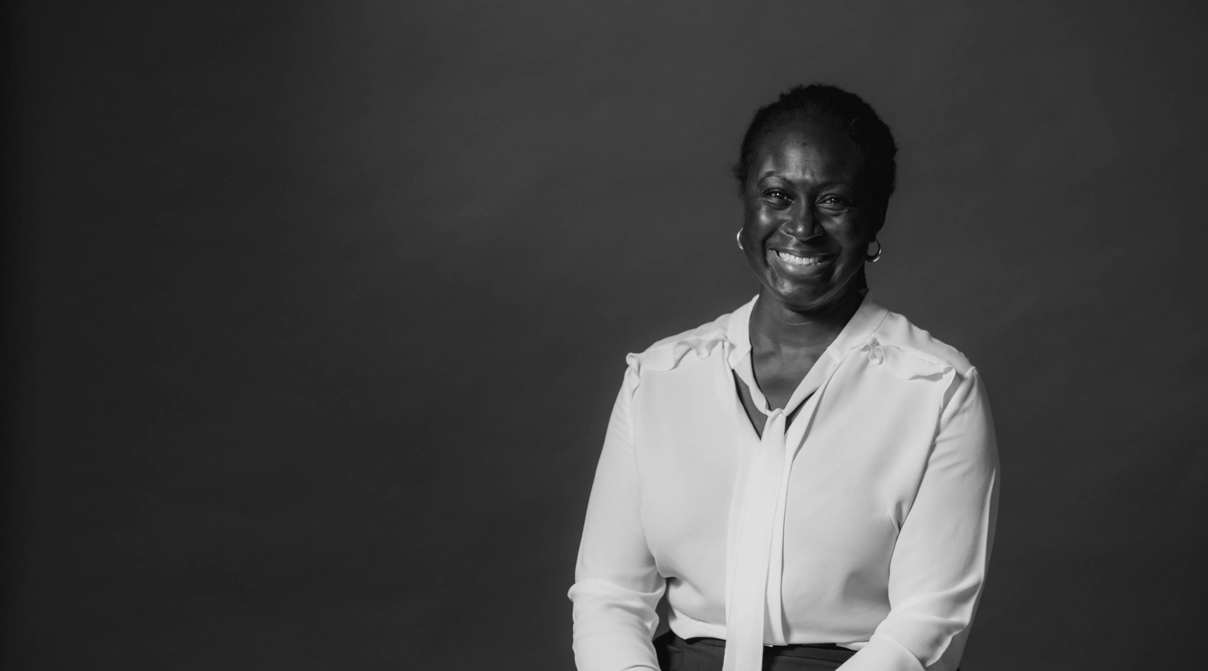
How YOU can help shape our future
Give us your feedback and suggestions
Take part in our upcoming working group to further develop the potential future state of Rotary
Apply for one of the new roles being tested in the Pilot
Stay informed

Slide 12
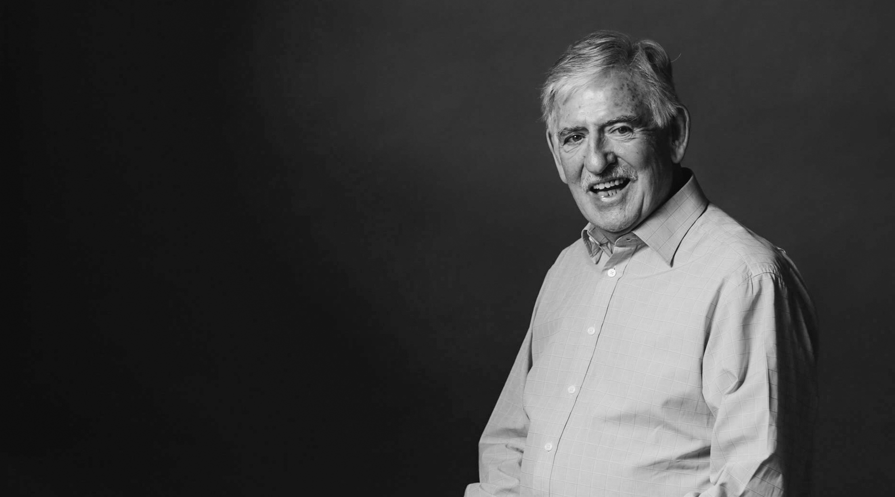
Learn more
CreatingTomorrowRotary.org
RotaryRegionalPilot@gmail.com
Follow the Pilot on Facebook

