Slide 1


  Zone 8
  Regionalisation
  Pilot
Forming Rotary Community Groups
September 2023
  Jyoti, Rotarian since 2016.
Notes:
Introduction with country specific welcome
The purpose of this presentation is to give you the information you need to understand how Rotary Community Groups will be formed.
It is intended for club leaders and members, District leaders, and regionalisation representatives/champions in Districts.

Slide 2
  What this presentation covers
      Regionalisation Pilot – Recap
      Rotary Community Groups – What are they?
      Rotary Community Leaders – What is their role?
      How will the Rotary Community Groups be formed?
      How will the Rotary Community Leaders be elected?
      FAQs
      Indicative timeline
Notes:
This presentation includes:
A quick recap of the Regionalisation Pilot
An explanation of Rotary Community Groups and Leaders
An outline of the processes for forming Rotary Community Groups and electing Rotary Community Leaders
Frequently asked questions
An indicative timeline for the implementation of Rotary Community Groups and Leaders

Slide 3
  Regionalisation Pilot - Recap
Rotary International
New leadership and governance body for Zone 8
Grow Rotary
One voice – partnerships, public image
Impact – Zone-wide projects
Efficiency – reduced duplication, technology, etc.
Regional Council
Access to expertise
Problem solving (e.g. conflict resolution)
Governance and administration (e.g. insurance)
Rotary programs (e.g. RYLA)
Development (e.g. membership, marketing, event management, using collaboration software, strategic planning, etc.
Members, Clubs, Rotary Community Groups
New level and type of club support
Facilitate collaboration – increasing community impact, profile of Rotary, membership growth and experience
Provide and access support for clubs and Rotary Community Groups
Rotary Specialists
Rotary Community Leaders
Notes:
The Pilot is introducing a new operating model which features three new volunteer roles that will support members, clubs and Rotary Community Groups to achieve their goals.
First is the Regional Council, which will be the leadership and governance body for Zone 8, enabling the Zone to grow Rotary, speak with one voice, increase our impact and operate more efficiently.
Secondly, there are Rotary Community Leaders, who will facilitate collaboration in Rotary Community Groups, provide support to clubs, and connect clubs and members to specialists and support resources as required.
Third is the Rotary Specialist, a very important role where volunteers provide their skills, knowledge and experience to members, Clubs, and Rotary Community Groups.
Clubs, members and Rotary Community Groups are at the centre of this operating model.
We’re now going to explore how Rotary Community Groups will be formed.

Slide 4


  Rotary Community Groups (RCGs) – What are they?
      A new way of grouping clubs based on commonalities such as:
      RCGs can meet in person, online or a combination of both, and choose how often they meet
      Clubs can also nominate a secondary grouping that will operate in online networks across the Zone e.g. environment, youth, DEI, etc.
          Geography
          E.g. clubs may be close together or spread out
          Type of club
          E.g. online clubs, passport clubs, corporate clubs
          Common feature
          E.g. shared language, specific cause
Notes:
As part of the Regionalisation Pilot, a new way of grouping Rotary and Rotaract clubs will soon be introduced. Each group will be known as a Rotary Community Group (RCG).
These groups are designed to foster greater collaboration among clubs so they can work more effectively and at a larger scale than they could on their own.
RCGs will be based on what clubs have in common, such as geography, type of club or common feature. They will meet in person, online, or a combination of both, and will choose how often they meet.
Clubs will also be able to nominate a secondary way they prefer to be grouped. Secondary groupings are optional, informal and will mainly be online.

Slide 5
  Rotary Community Leaders (RCLs) – What is their role?
      Each RCG will elect their own RCL, who will:
            Facilitate RCGs to thrive and grow:
                Establish larger scale partnerships
                Increase community impact
                Build a higher public profile
            Provide or access support for RCGs and individual clubs:
                Problem-solving
                Governance and administration
            Attract new club members
            Increase club member engagement and satisfaction
            Rotary programs
            Development
*Please note that The Rotary Foundation will remain with Districts*
Notes:
Each Rotary Community Group will elect their own Rotary Community Leader (RCL), a facilitator who will provide and access support for the clubs in their group as needed.
Rotary Community Leaders will support clubs to:
Establish larger scale partnerships
Increase community impact
Build a higher public profile within their community
Attract new club members
Increase club member engagement and satisfaction
RCLs will provide support for RCGs and individual clubs directly, and will also access more specialised support from the Rotary Specialist Network. The Specialists from this network will be a combination of local and Zone-wide experts. Local experts who are supporting clubs now will be invited to join the Rotary Specialist Network.
Current arrangements regarding The Rotary Foundation will continue for the duration of the Pilot.

Slide 6
  How will Rotary Community Groups (RCGs) be formed?
      Clubs will tell us how they want to be grouped via the Club Preferences form
      We will then work with District leaders to determine the best groupings for that District, accommodating club preferences as much as possible
                Where that’s not possible, we’ll work with the clubs involved to discuss available option/s
Notes:
Clubs will tell us how they want to be grouped via the Club Preferences form. The Regionalisation Team and District leaders will then use the responses provided in the form to determine the best groupings for that District.
Club preferences will be accommodated as much as possible. Where that’s not possible, we will include the clubs involved to discuss available options.

Slide 7
  How will Rotary Community Groups (RCGs) be formed?
      Each club’s President or Secretary will complete one Club Preferences form on behalf of their club
      A club’s President or Board doesn’t decide for the club
      The responses in the form need to reflect the majority view of club members
      It is expected that clubs will discuss/workshop the questions in the form together
Notes:
Club Presidents and Secretaries will receive a link to complete the Club Preferences form. Each club will submit one form only.
It is expected that clubs will have a club forum or workshop to discuss the questions together and gather members’ views. A club’s preferences are not up to a club’s President or Board to decide alone.
The responses in the Club Preferences form need to reflect the majority view of club members.

Slide 8

  Questions in the Club Preferences Form
      What are we most passionate about?
      What are our biggest strengths and challenges?
      What do we imagine our club could achieve with increased support and collaboration?
      What is our preferred primary way of being grouped with other clubs?
      Are we interested in being part of a secondary grouping? If so, based on what shared interest?
Notes:
These are the main questions in the survey:
What are we most passionate about?
What are our biggest strengths and challenges?
What do we imagine our club could achieve with increased support and collaboration?
What is our preferred primary way of being grouped with other clubs?
Are we interested in being part of a secondary grouping? If so, on what shared interest?
There is also a question for the person submitting on behalf of their club to verify that the responses reflect the majority view of members, and to specify how the views of their club members were gathered.

Slide 9
  How will Rotary Community Leaders (RCLs) be elected?
      Once RCGs are formed, they will meet to discuss:
                their vision
                what leadership and support they will need
                how and when they will meet
      The outcomes of this discussion will be documented and circulated to all members, and will supplement the position description for their RCL
      Once this is complete, nominations for RCLs will open
      Each club in an RCG will submit one preferential vote to elect their RCL
Notes:
Once Rotary Community Groups are formed, they will meet to discuss:
The vision for their RCG
What leadership and support they will need
What arrangements will work for their group
The outcomes of this discussion will be documented and circulated to all clubs in the RCG. It will supplement the position description for their Rotary Community Leader, which will give potential candidates a better sense of what the role will entail. Once this is complete, nominations for the RCLs will be opened.
Only the clubs in a specific RCG will vote to elect their own Rotary Community Leader, with each club submitting one vote.
A preferential voting system will be used.

Slide 10
  FAQs
Q. Is there a minimum and/or maximum number of clubs in each Rotary Community Group?
No, but we envisage most groups will have between 12 and 25 clubs. However, there will be exceptions.
Q. If my club becomes part of a large Rotary Community Group, we will get less support than we do now?
No. Rotary Community Groups are designed to enhance the existing support available to clubs. Your Rotary Community Leader will work closely with you to increase your community impact, raise Rotary's profile, attract members, and enhance member satisfaction.
Q. What if a club doesn’t want to join a Rotary Community Group?
All clubs will be allocated to a Rotary Community Group and have a Rotary Community Leader who will support them if and as needed. It is an important principle of the Pilot that no club is left behind. However, clubs are autonomous and can choose how much they participate in their group.
Q. Can my club be in a Rotary Community Group with neighbouring clubs in another District?
Yes. All clubs will remain in their Districts, but the clubs within a Rotary Community Group can span more than one District. In such cases, their Rotary Community Leader would work closely with the District Governors involved.
Q. What if my club doesn’t want to change the group/cluster/area they are in now?
You can let us know if you would prefer to be grouped with specific clubs in the club preference form, and we will do our best to accommodate club preferences. However, this is an opportunity to try a new way of operating and enable clubs to make a bigger difference.
Q. Will we still have District Governors?
Yes. Rotary Community Leaders and District Governors will liaise collaboratively, with a focus on unified support for clubs and members.
Notes:
These are some of the common questions that have been asked so far.
We welcome any other questions.
(Go through questions and answers)

Slide 11
  Rotary Community Groups (RCGs) and Leaders (RCLs) indicative timeline
Today
109 days
100%
20 days
100%
District leaders and Regionalisation team review survey results together and prepare draft groupings
With initial support from District leaders, RCGs meet to determine how they will work together
699 days
Club Presidents discuss with their members how they would like to be grouped
Online workshops for Club Presidents, Assistant and Area Governors, G-train, RDRs
0%
92 days
0%
Arrangements made for RCG establishment meetings
365 days
0%
426 days
0%
120 days
0%
Sep 2023
Oct 2023
Nov 2023
Dec 2023
Feb/Mar 2024
365 days
0%
122 days
0%
91 days
0%
Nominations for RCLs called and elections held
Club survey submitted by 29 October, saying how clubs would like to be grouped
912 days
RCGs finalised, accommodating club preferences as much as possible
0%
912 days
0%
212 days
0%
Notes:
The timeline for identifying Rotary Community Groups and Community Leaders is:
In the week of 18 September, the Presidents and Secretaries of Rotary and Rotaract clubs will be emailed the link to the Club Preferences form, which they will use to indicate how they would like to be grouped together.
From 24 – 29 September, there will be three options to attend an online workshop for Presidents, Assistant and Area Governors, the G-train, and Regionalisation District Representatives who would like to support clubs to discuss how they would like to be grouped.
The Club Preferences form must be completed by 29 October.
District leaders and the Regionalisation team will review the survey results together and work on the groupings, liaising with clubs where needed.
The new Rotary Community Groups are expected to be advised to clubs in November.
RCGs will then meet to determine how they will collaborate and how the RCL role will work for their group. This is likely to be in February.
Club members will then be invited to express interest in nominating for a Rotary Community Leader role in their Community Group. This is likely to be in late February.
Community Leaders will be elected by late March/early April 2024 to enable them to participate in a learning program in preparation for their new role to commence in July 2024.

Slide 12
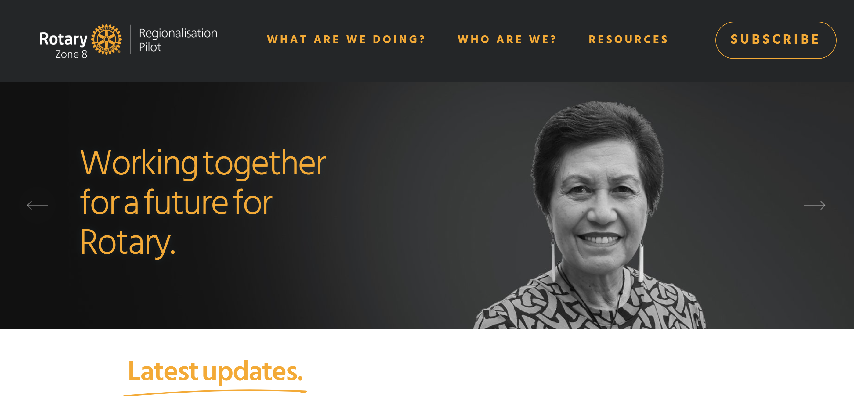
  For more information
      The Creating Tomorrow website is being updated regularly. For more information on the latest progress of the Regionalisation Pilot, visit CreatingTomorrowRotary.org
Notes:
The Creating Tomorrow website is your primary source of information for the Regionalisation Pilot. It is now being updated regularly with the latest news on the Pilot’s progress.
If you have any questions, you can email the Regionalisation Pilot Team directly at RotaryRegionalPilot@gmail.com.

